Slide 1
ENSE 477 February 25th Project Bazaar
URStreamSight
Avery Cameron, Raymond Knorr, Noah Rowbotham
February 25, 2021

Slide 2
Team Members
Avery Cameron
Project Management/Flexible Developer
Help with Front-End and ML as needed
Raymond Knorr
Lead API and Front-End Developer
Manage collaboration with Prairie Robotics
Noah Rowbotham
Lead Machine Learning Technician
Lead development of classification model and documentation
Notes:
Avery Cameron: Project Manager/Flexible Developer
Manage our GitHub structure and CI/CD
Organize project meetings and milestones
Manage project documentation
Help with Front-End and ML as needed
Raymond Knorr: Lead UI/API Developer
Manage integration and documentation of our software with Prairie Robotics
Manage Trello board for workflow organization
Manage communications between URStreamSight & PrairieRobotics
Noah Rowbotham: Lead Machine Learning Technician
I lead development of machine learning training and implementation
I manage the integration of Amazon services with our ML workflow
I develop on the aaeon onboard computer which facilitates the collection of data from recycling collection vehicles

Slide 3
Our Partnership
Developed in cooperation with our industry partner, Prairie Robotics
Progress made in our project will be used and expanded on by Prairie Robotics following its completion
Notes:
This capstone opportunity was made available to us by Prairie Robotics, a local startup here in Regina formed by past alumni of the University of Regina.
Progress made in this project will be adopted and expanded on by Prairie Robotics following its completion.

Slide 4
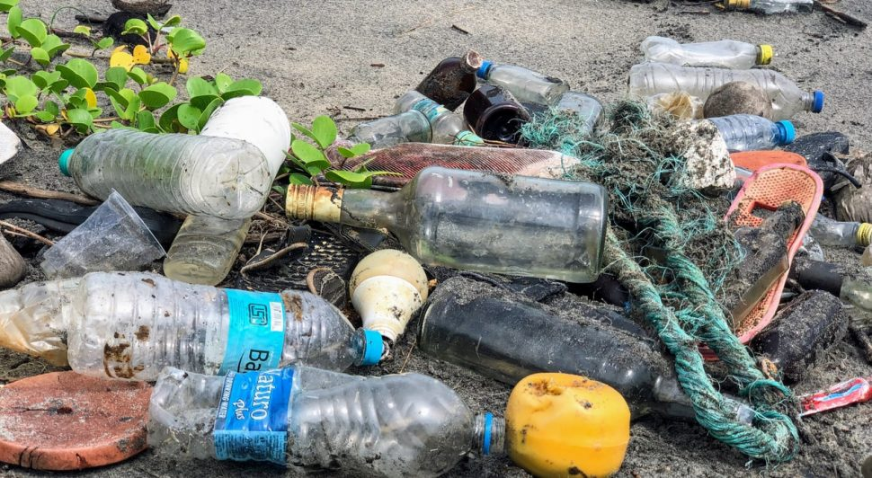
What is URStreamSight?
Problem:
Citizens across Canada are confused regarding what proper recycling is.
Gap we are filling:
Giving data to municipalities to allow them to track/correct problem at its source (the people recycling). We are not actually sorting any recycling.
Innovation we are introducing:
Web application for municipality workers that scores recycling on a neighborhood basis and displays the data. Videos are captured from the bin of recycling trucks and ran through a waste classifier to determine whether the recycling is contaminated.
Notes:
Web application for municipality workers that scores recycling on a neighborhood basis and displays the data. Videos are captured from the bin of recycling trucks and ran through a waste classifier to determine whether the recycling is contaminated.
This is a web application for municipality workers to review contamination in recycling bins and display reports to help with decision making. Pictures are captured when a bin is tipped into the recycling truck and contamination is identified with machine learning, this is then displayed in our front end portal for users.

Slide 5
Scrum Dates
Feb 5, 2021 - Feb 25, 2021
Notes:
This scrum ran from Feb 5, 2021 - Feb 25, 2021

Slide 6

Status Description
API - Green
Testing - Green
Front end - Green
Machine Learning - Yellow
Image Pipeline - Green
Overall - Green
Notes:
API Status: Green
We worked on adding a couple more endpoints over the past couple weeks and did some refactoring to improve our API in general. This included additional path and query parameter validation which will help ensure the integrity of our API requests and help with testing.
Testing Status: Green
We completed testing of one set of endpoints following pairwise comparison testing methods, and this will be very easy to expand to the other endpoints. We did some research for testing affected files in the mono repo which should improve testing and our CI/CD pipeline efficiency.
Frontend Status: Green
We worked on the front end and tied it into our API to get real information. We are working on adding additional components such as graphs and tables and some user control for admin users.
Machine Learning: Yellow
We have trained a bin detection binary classifier that is used to create the training data for our contaminants classification model as well as collect samples of household recycling for contaminant inferencing. We are also testing a pre-trained mask r-cnn model to evaluate if real time processing is feasible on the collection vehicle. We feel that machine learning deserves yellow status due to slight delays that we will elaborate on shortly.
Image Pipeline: Green
Currently, we have two data pipelines both over 50% complete. We have a training pipeline that takes a backlog of video of waste collection and converts it to training sample frames. We also have a production pipeline that originates from the collection vehicle. An onboard computer uses our bin detection model to create sets of frames per household that can be used to make predictions on the contaminants present.

Slide 7
Team Member Contribution
Avery
API Fixes
Front end migration
Integration tools research
Ray
API Refactoring
Front end graph pages
Integration tools research
Noah
Completed bin detection process
Setup GPS & cellular internet for onboard computer
Integration tools research
Notes:
Avery:
Over this scrum I was working with Ray on the API fixing some endpoints based on test results and I also worked on some research for testing and our CI/CD pipeline. I worked with Ray to move our front end into the monorepo that we share with Prairie Robotics to promote code reuse, and did pair programming with Ray in development. This week, I also did some research and reporting for front end integration tools that may be useful in the future for Prairie Robotics.
Ray:
As Avery mentioned, I fixed several API endpoints and did some general refactoring to have more robust input validation. We moved our front-end into the Prairie Robotics monorepo and I developed some graph displays in React. I also did some research on potential integrations with a tool for user retention, engagement and sentiment analysis.
Noah:
I also worked on some integration analysis for adding programmatic calling and emailing to stream sight. When not working on analysis I was busy finishing and deploying our bin detection process including setting up gps and cellular internet for the aaeon onboard computer.

Slide 8
Project Issues and Changes
Small changes to our front-end design, will be elaborated on in future scrums
Contaminant classifier quality and completeness
Notes:
We are looking into small changes to our UI.
Due to delays, we are likely not going to make the progress we had intended to make regarding our contaminant classifier. Regardless, we intend to get as far as we can and we will supplement our API and front-end with mock data as necessary.

Slide 9
Project Demo
API & Testing | Front-end
Notes:
(AVERY GOES FIRST RAY)
API:
Database | Seeding Data | Tests
Postman Requests, showing RBAC working (just show postman, and changing permission)
Front-end
Quick demo of different pages

Slide 10
Project Demo
Machine Learning | AWS | Aaeon Board
Notes:
Now I am going to demo how we collect the data that our API and Front-end manage and display.

Slide 11
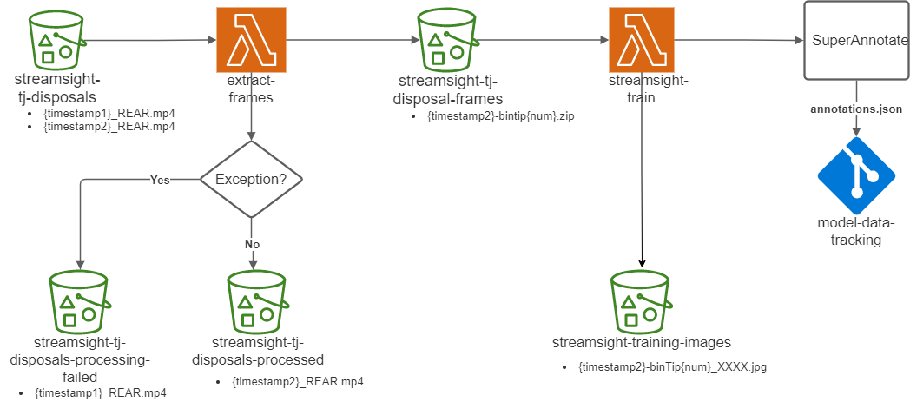
Pipelines - Training Data
Notes:
This diagram shows the process for generating training data from our existing recycling footage from TJ Disposals.
Footage is broken into frames, those frames are grouped into bin tips, and then stored for training.
Prairie Robotics sends those frames to super annotate to get annotations.
Annotated images are ready for use in training object segmentation tracking and contaminant classification models.

Slide 12

Training Pipeline - Video to Sample Process
Old Angle
New Angle
Notes:
We have recently changed our camera angles to improve data quality and general usefulness.
The video on the left shows the old input angle, while the right video shows our new standard.

Slide 13
Training Pipeline - Video to Sample Process
Rear Camera Angle
Notes:
This is an example of footage collected by the rear camera mounted within a recycling collection vehicle.

Slide 14
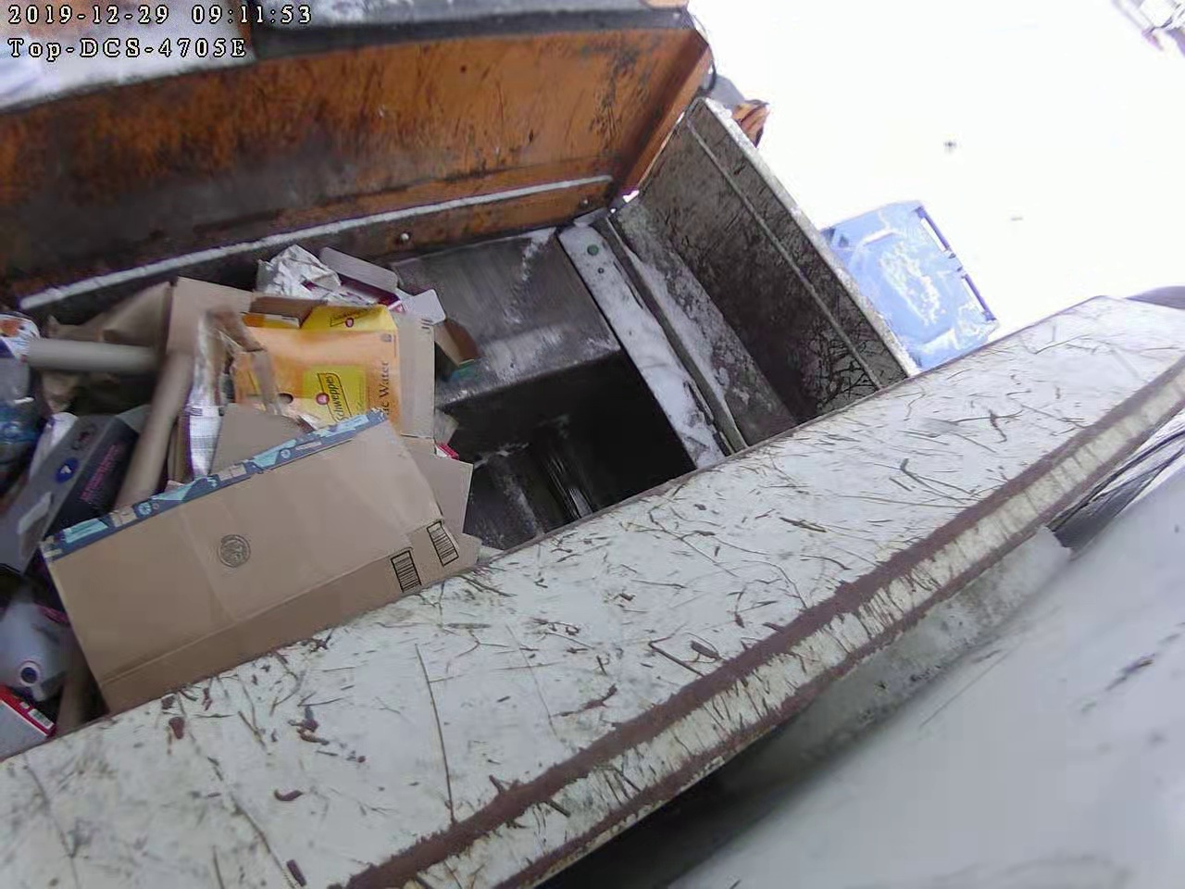
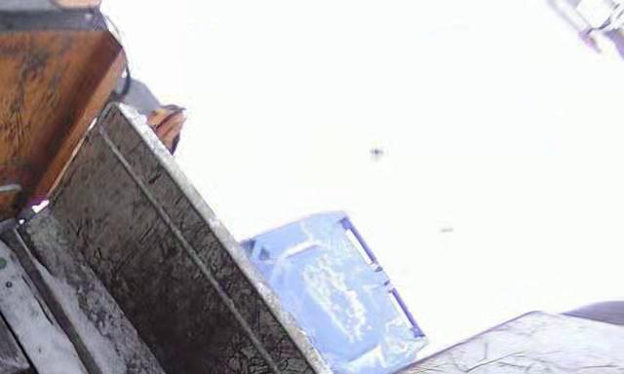
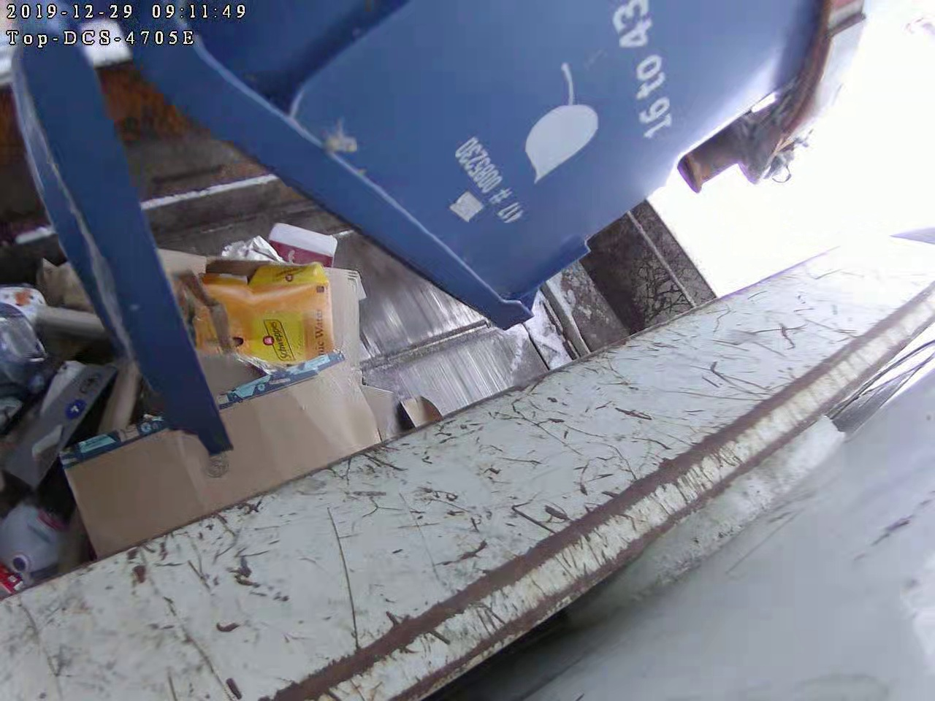
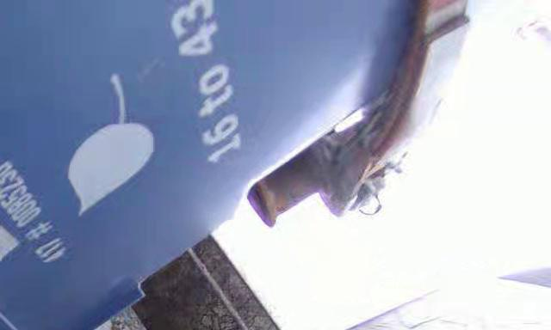
Video to Sample Process - Old Cropping
Crop frame to corner
Detect if bin present
Notes:
We used to crop the old angle to the top corner. We then trained a model to predict if a bin was present based on that corner shot.

Slide 15
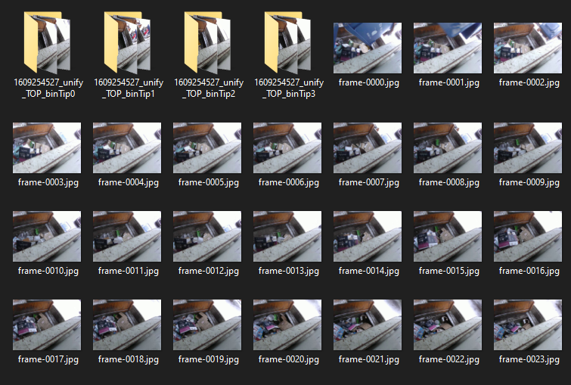
Video to Sample Process - Old Output Frames
Notes:
Using some basic logic and the predictions from our bin detection model we could generate frames and group them into bin tips based on the detection of a raised bin.

Slide 16
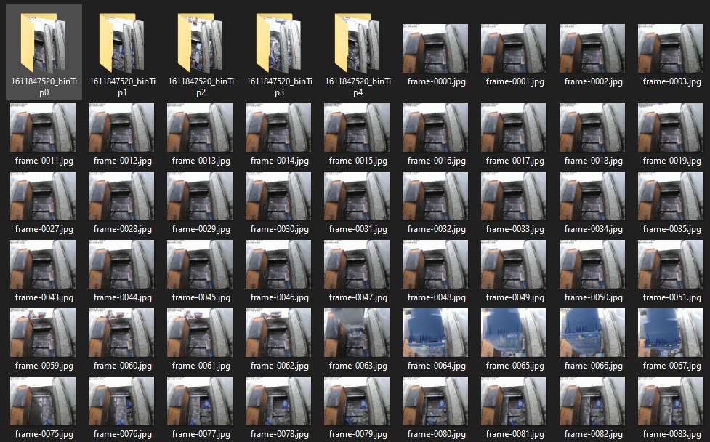
Video to Sample Process
Notes:
We can take that footage and decompose it into frames, and then group those frames into bin tips using our bin detection model.

Slide 17
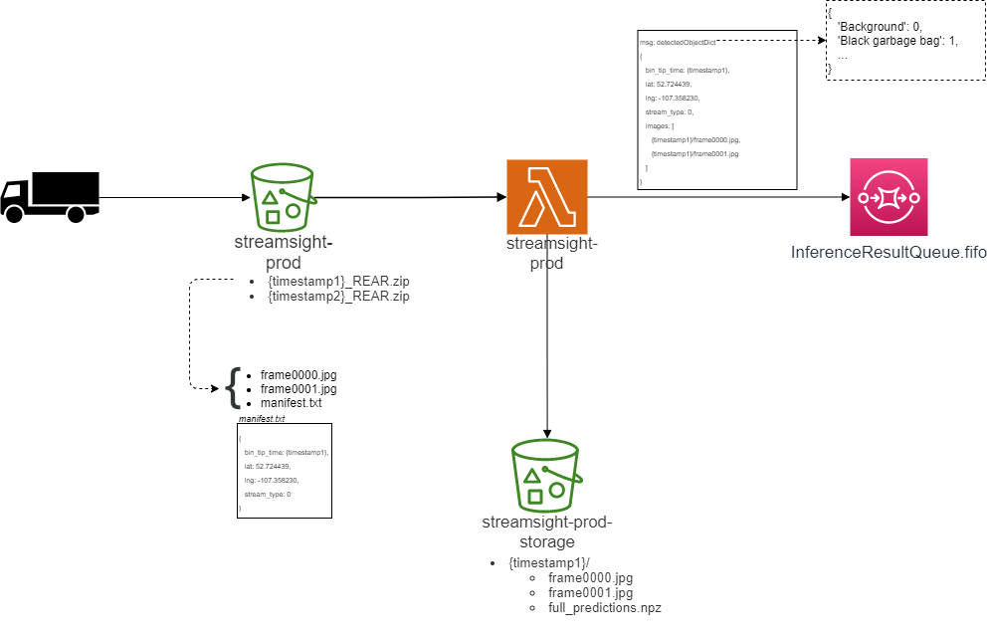
Pipelines - Production Data
Notes:
Our production pipeline is how bin tips will be inferenced. This pipeline will also supersede the training pipeline and become our only process for collecting training data in the future.
In this process, frames are collected from the collection vehicle rather than a video stream.
These frames are stored in a zip file along with a manifest file that records some other useful information.
Each frame within a bin tip will have inference applied and those predictions will be stored with each bin tip.
The resulting output is a SQS message output from AWS that contains the predicted contaminants in the frame. A lambda function in AWS processes the SQS message and stores it an RDS hosted by amazon.
There is a video up on our GitHub that demo’s our application streamsight-io that uses our bin detection model to facilitate the collection of production ready data.

Slide 18
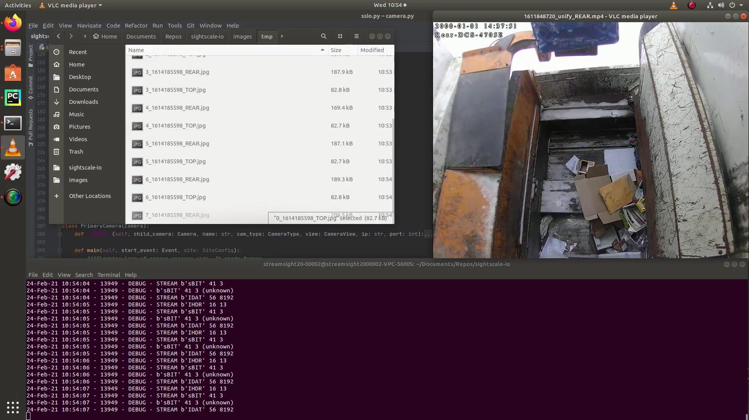
Production Pipeline - Bin Detection Process
Notes:
This demo on the aaeon onboard computer will demonstrate how production ready bin tip samples are collected using our application streamsight-io and our bin detection model.

Slide 19
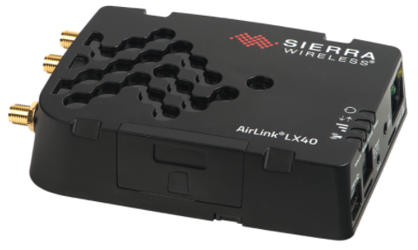
Other Progress
Setting up a Sierra LX40 for cellular comm’s
Testing Mask R-CNN for real time inference vs. post-upload inferencing
Average single image inference of 6s, would need to be sub 5s for real time
Notes:
Other smaller tasks I have completed include setting up a cellular modem so that our Aaeon board has a more stable wireless connection than the current wireless modem in use.
I’ve also been working on testing a pre-trained mask r-cnn on single image inferencing to see if real time inferencing on the Aaeon board is a feature that could be implemented.

Slide 20
Plans For Next Scrum
Ray
Front-end component development
CI/CD pipeline
Avery
Adding tests
CI/CD pipeline
Noah
Comparing backbones for Mask R-CNN as a contaminants classifier (garbage bags, styrofoam plastics, pizza boxes, etc.)
Modifying GPS recording, if GPS fails during a service route, label bin tips with last known GPS reading
Notes:
Ray: Adding additional front-end components, and planning CI/CD pipeline for our API and Front End to be hosted on AWS with Avery
Avery: Work with Ray on the frontend components and pages and adding tests to the API in spare time. CI/CD investigation with Ray
Noah: I will be working on comparing possible backbone networks for our mask r-cnn model for classifying contaminants as well as modifying our current gps recording

Slide 21
Group reflection
Do you feel you are on track?
Yes, we feel we are green overall and on track with our work. Starting work on the front end and having the feedback and from Prairie Robotics and thoughts from the municipalities is very helpful. And the machine learning and aaeon board prep is going well.
What progress does the team feel particularly great about?
We feel particularly great about starting on the front end and the research we did on tools that could be integrated and the cost/benefit analysis of them.
Do you feel there are barriers to your success (if any)?
Pressures of other courses are possible barriers. The knowledge required for integrations and our model training could delay progress but at the moment things are going smoothly.
Do you need any help going forward?
We will continue to meet with Dr. El-Darieby and Sam for feedback, other than that insight into where we can improve in the scrum comments would be nice.
Any other questions or concerns?
No concerns at the moment, just looking forward to feedback on our project and presentation.
Notes:
Ray does first two,
Noah does next two,
Avery does last one
Was this level of description of our project understandable
Was this level of description of our project understandable

Slide 22
Image Refs
https://cleanriver.com/how-to-reduce-recycling-contamination/
https://i.pinimg.com/originals/e9/2c/79/e92c79bbf86dd1295f94bb279fe7152a.jpg

Slide 23
Questions or Comments?

